Slide 1

Building and Securing a Network
Abdelrhman Hamed
Ayman Salah
Aya Mansor
''A Step-by-Step Network Design and Security Implementation''

Slide 2
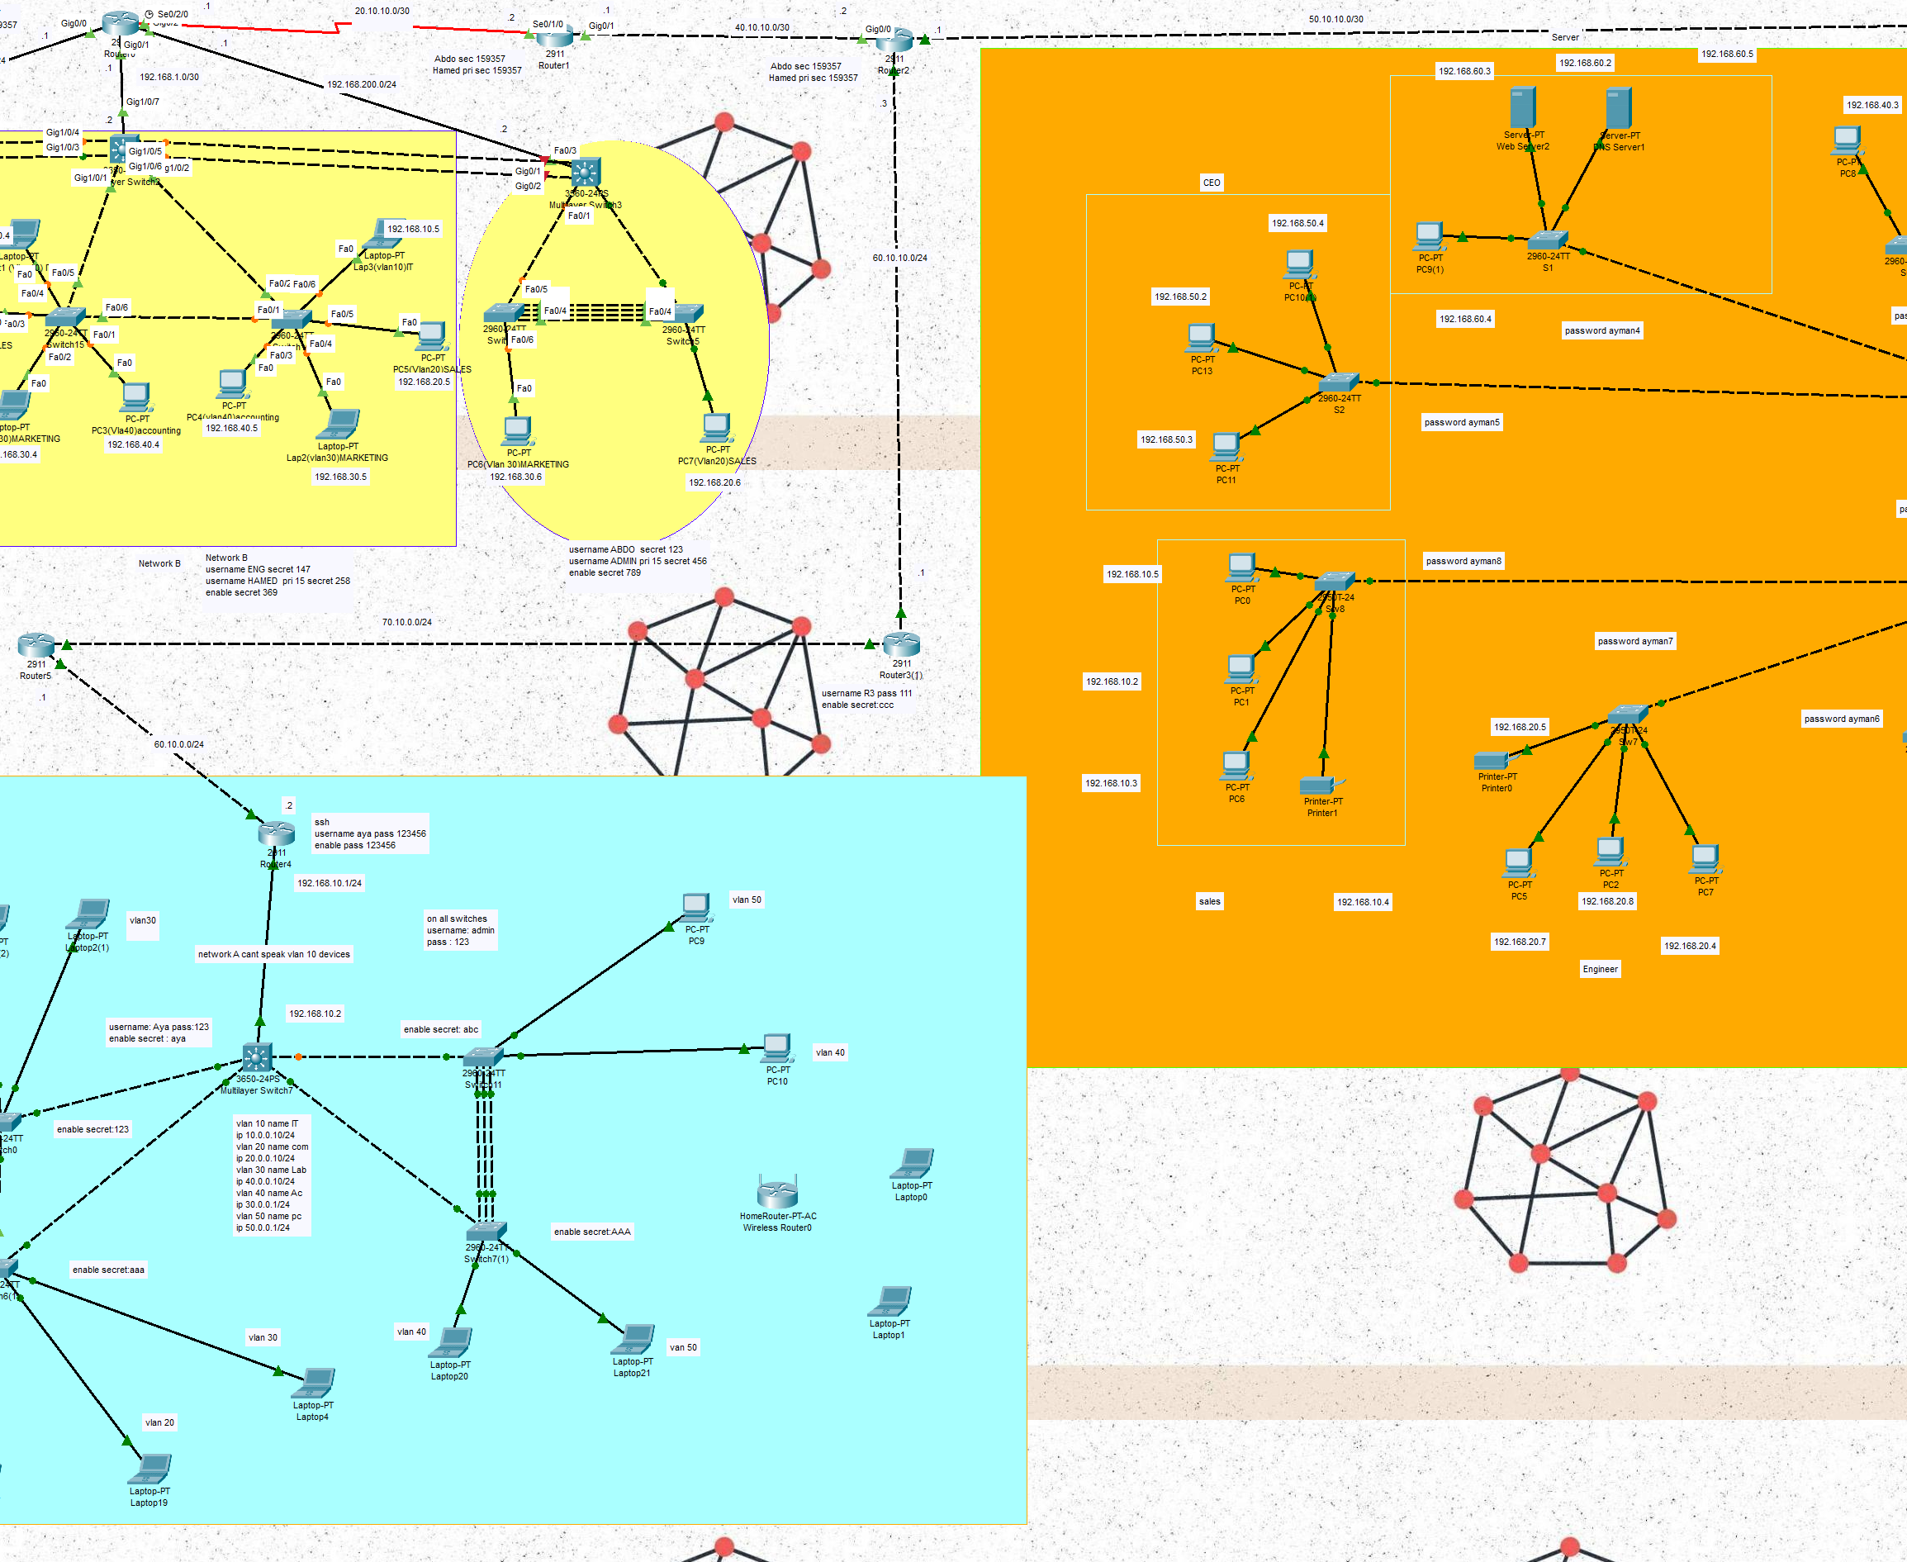
Project Overview
Network Design and Configuration
VLANs and Inter-VLAN Routing
Network Security Implementation
NAT Implementation and Testing
IPv4 Routing and Connectivity
Implementing Port Security on Cisco Devices

Slide 3
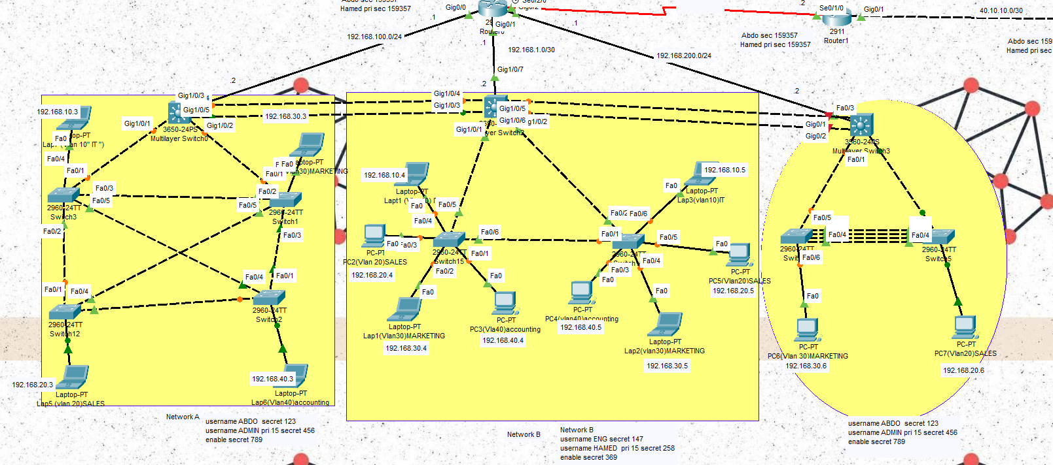
Network Design and Configuration
Brief on topology, IP addressing scheme, and devices used (routers, switches)

Slide 4
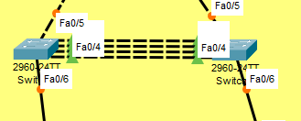
EtherChannel in project
Increased Bandwidth
Redundancy and Fault Tolerance
Load Balancing

Slide 5
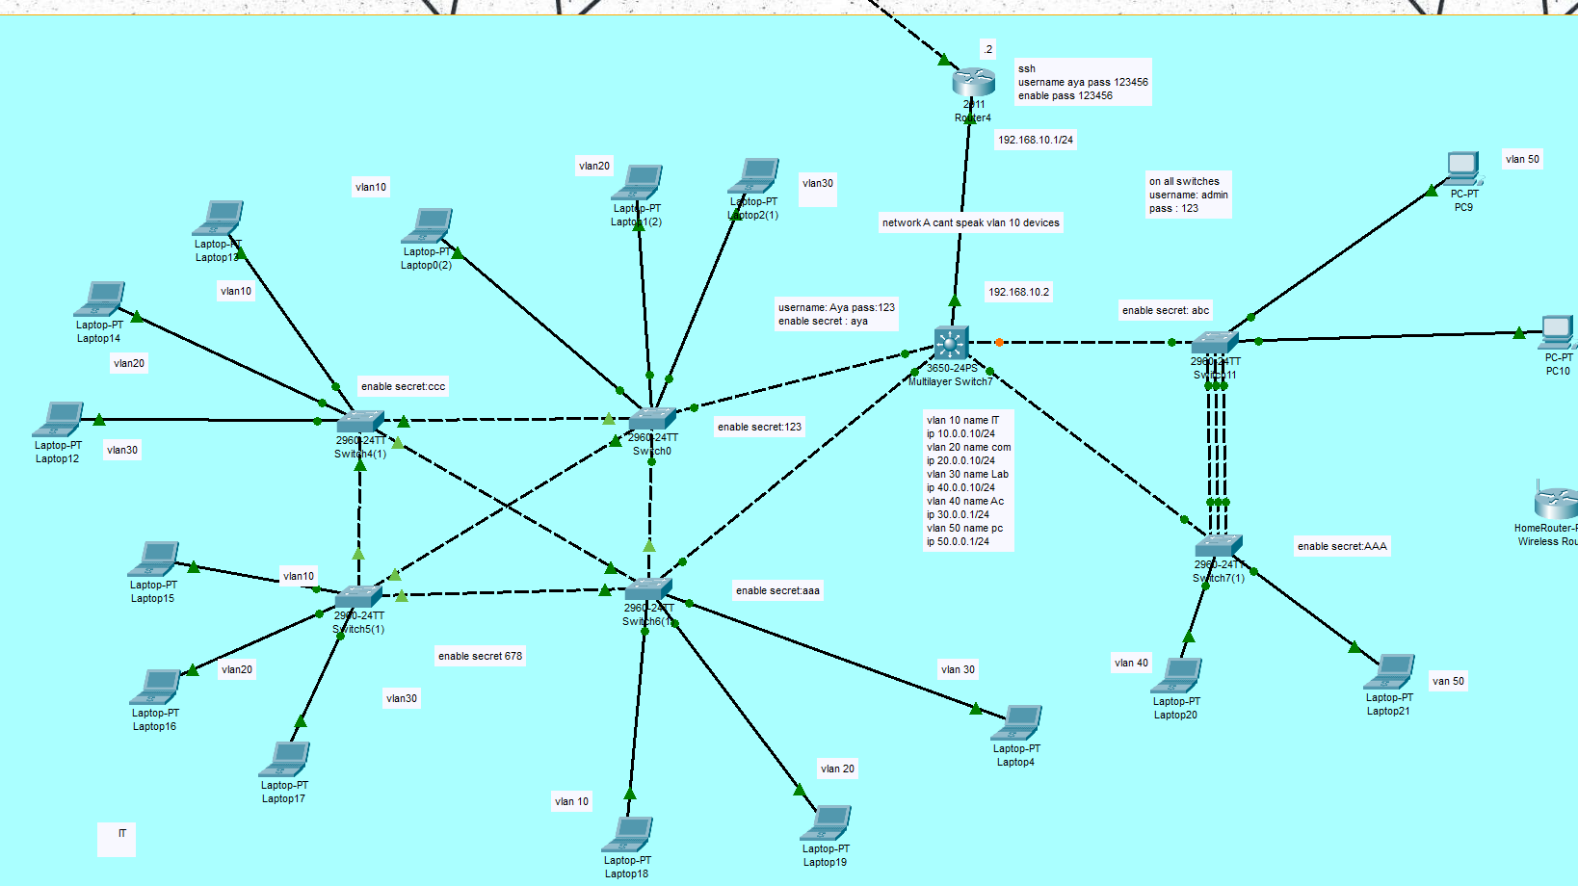
VLANs and Inter-VLAN Routing
Use inter vlan to allows communication between devices in different VLANs, which is essential for network segmentation while maintaining connectivity. It ensures efficient traffic flow and enhances network security by controlling access between VLANs.

Slide 6
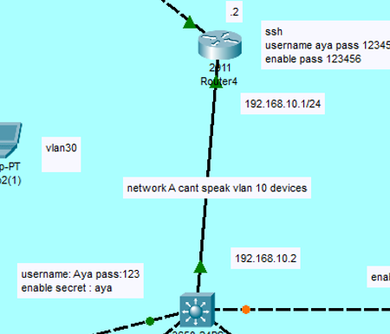
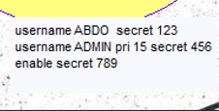
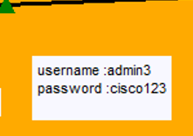
Network Security Implementation
Include key configuration commands for port security and ACLs
how these security features help protect the network

Slide 7
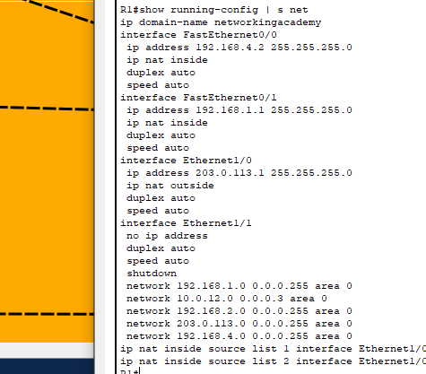
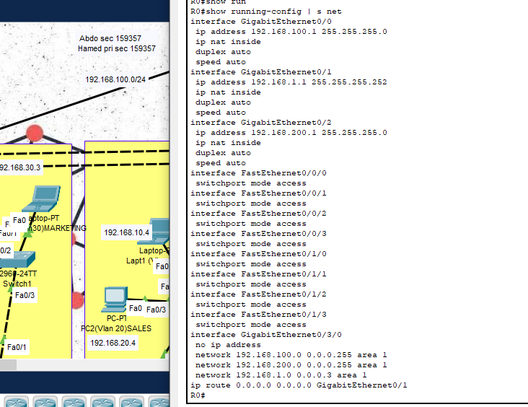
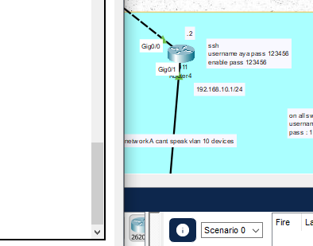
NAT Implementation and Testing
allows private IP addresses to be mapped to public IPs, enabling devices in a local network to access external networks like the internet. It also enhances security by hiding internal IP addresses from external networks.

Slide 8
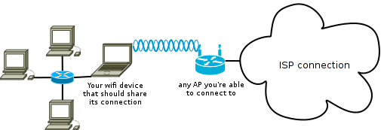
Wireless LAN Controller (WLC): Centralized Management for Secure Wireless Networks
Optimizing Wireless Connectivity and Enhancing Security through WLC Configuration and Control

Slide 9
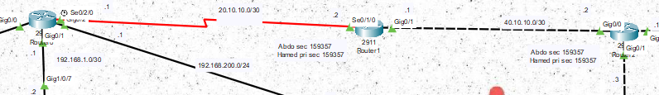
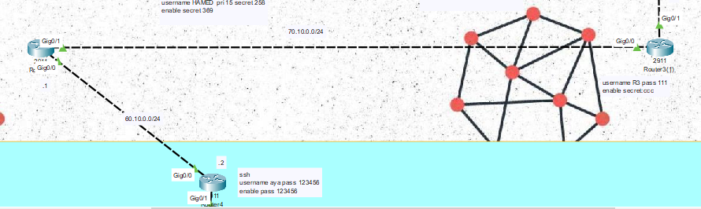
IPv4 Routing and Connectivity
Optimizing IPv4 Routing with OSPF: Enhancing Network Scalability and Efficiency
A Deep Dive into OSPF Configuration for Seamless IPv4 Connectivity in Dynamic Networks

Slide 10
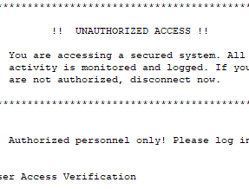
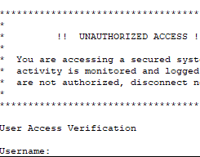
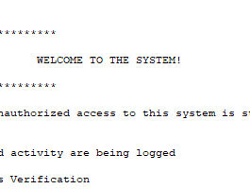
Configuring Banners on Cisco Switches and Routers
Configuring Banners on Cisco Switches and Routers
A Guide to Setting Up Message of the Day (MOTD), Login, and Exec Banners for Effective Network Management

Slide 11

Implementing Port Security on Cisco Devices
Controlling Unauthorized Access and Enhancing LAN Security through Port Security Configuration

Slide 12

Question

